Slide 1
AI-Powered Collections Strategy
Leveraging Agentic AI for Scalable, Fair, and Effective Debt Management at Geldium

Slide 2
How the System Works
Inputs:
Customer demographic data (e.g., age, location, employment status)
Financial data (e.g., income, credit score, credit utilization, debt-to-income ratio)
Behavioral data (e.g., missed/late payment history, account tenure, card type)
Additional engineered features (e.g., Total_Missed_Late_Payments)
Decision Logic:
LightGBM-based predictive model estimates delinquency risk using historical patterns
GenAI assists in summarizing behavioural trends and enhancing feature interpretation
Business logic layer categorizes customers into risk segments for intervention
Notes:
Prompts to try:
Generate a simple outline for an AI collections system workflow, including inputs, decision logic, action triggers, and learning loop.
List 3–5 key customer attributes that would be most predictive for collections decision-making, and explain why each one matters.
Suggest examples of business rules and AI-driven actions the system could use at different risk levels (e.g., low, medium, high risk).
Create a rough sketch or step-by-step description of how customer data flows through the system from intake to action.

Slide 3
How the System Works
Actions:
Low- to mid-risk: Automated reminders, personalized financial nudges via GenAI
High-risk: Pre-emptive hardship offers, routed through escalation protocol
Complex scenarios: Flagged for manual review by collections specialists
Learning Loop:
Model retrained periodically using feedback from real-world outcomes
A/B testing and continuous monitoring refine messaging, timing, and targeting
Synthetic data augmentation used for low-volume edge cases (validated for realism)
Notes:
Prompts to try:
Generate a simple outline for an AI collections system workflow, including inputs, decision logic, action triggers, and learning loop.
List 3–5 key customer attributes that would be most predictive for collections decision-making, and explain why each one matters.
Suggest examples of business rules and AI-driven actions the system could use at different risk levels (e.g., low, medium, high risk).
Create a rough sketch or step-by-step description of how customer data flows through the system from intake to action.

Slide 4
How the System Works- Visual Flow
AI-Driven Collections Workflow
Workflow:
Data Collection → 2. Feature Engineering + GenAI Summarization → 3. Risk Prediction (LightGBM) → 4. Decision Layer (Business Rules + AI) → 5. Action Delivery → 6. Feedback & Retraining
Example Scenario:
Input: Age 27, unemployed, Business card holder, missed 2 payments
Output: 85% delinquency risk
Action: Trigger SMS + hardship plan + human flag
Notes:
Prompts to try:
Generate a simple outline for an AI collections system workflow, including inputs, decision logic, action triggers, and learning loop.
List 3–5 key customer attributes that would be most predictive for collections decision-making, and explain why each one matters.
Suggest examples of business rules and AI-driven actions the system could use at different risk levels (e.g., low, medium, high risk).
Create a rough sketch or step-by-step description of how customer data flows through the system from intake to action.

Slide 5
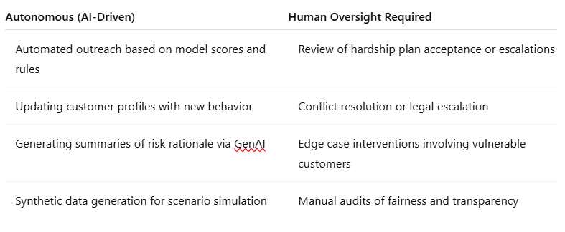
Role of Agentic AI
Notes:
Prompts to try:
Explain how agentic AI could automate financial collections while keeping humans in critical decision points.
List 3–5 examples of collection actions, and classify each as best suited for full automation or requiring human oversight, with a brief reason why.

Slide 6
Responsible AI Guardrails
Governance and Guardrails for Responsible AI
Fairness Audits: Regular evaluations across demographic segments to detect and mitigate bias
Explainability: SHAP value integration and GenAI-generated risk summaries for transparency
Regulatory Compliance: Adherence to GDPR, ECOA, and RBI frameworks with audit-ready logs
Human-in-the-Loop: Manual approval workflows for hardship triggers, legal notices, and disputes
Synthetic Data Controls: Use restricted to exploratory testing, subject to statistical validation
Notes:
Prompts to try:
List key fairness, transparency, and compliance practices to build into an AI-powered credit collections system.
Suggest specific ways to monitor and audit the system over time to ensure it stays fair, compliant, and effective.

Slide 7
Expected Business Impact
Business Value of the AI Collections System
Quantitative Impact:
20% reduction in delinquency rate through early, targeted outreach
25% increase in recovery rate due to better segmentation and messaging
30% reduction in manual effort via automation of routine tasks
Higher model performance via retraining (expected uplift in AUC > 0.85)
Qualitative Impact:
Improved customer engagement via timely and personalized support
Greater trust and perceived fairness due to transparent decision-making
Compliance-ready system with ethical guardrails and auditability
Scalable framework that evolves with customer behavior and regulation
Notes:
Prompts to try:
Suggest KPIs for an AI-powered collections strategy that balances business outcomes with customer fairness.
Describe 2–3 ways an AI collections system could improve both operational efficiency and customer experience.

